Slide 1
BITS Pilani
Dr. Lavika Goel
Assistant Professor
Department of CSIS
Pilani Campus

Slide 2
Statements: Structured Programming
Pilani Campus

Slide 3
Topics
Introduction
The Need for Structured Programming
Syntax Directed Control Flow
Conditional statements
Looping Constructs: definite and Indefinite
Case statements
Handling special cases in loops
Programming with Invariants
Pilani Campus

Slide 4
Introduction
Structured programs reduce the effort of understanding proportional to the program length.
Basic unit of Imperative programming: Actions which can change the value of a variable.
Example:
Assignment: x=2+3; or x=A[i];
Procedure calls: write(x);
Pilani Campus

Slide 5
Static programs, Dynamic Computations
for (i=1;i<3;i++)
{
printf(“%d %d”, i, i*i);
}
While (input)
{
printf(“Hello”);
}
We do not know the no. of times the loop will be repeated. It will be known at run-time.
Static text is different from the dynamic computations that occur when the program runs.
Pilani Campus

Slide 6
Design principles for Imperative Languages
In order to understand the computations in a program when the program runs, control flow constructs are designed with the principle:
“Structured programming: Structure of the program text should help us understand what the program does.”
Efficient design of language constructs is important in structured programming.
Pilani Campus

Slide 7
Example
Remove adjacent duplicates from a list of elements.
112223144 => 12314
Solution: Treat the input as a list of runs instead of a list of elements where a run consists of 1 or more copies of the same element.
i.e.
read element(x);
write(x);
skip past the duplicates of x;
Pilani Campus

Slide 8
Invariants: program design
Invariants are a key concept in designing imperative programs.
Invariant at some point in a program is an assertion (true/false condition) which holds whenever control reaches that point.
Invariant is a property of a program point (assertion).
Invariants help in relating the static source text and its dynamic computations so that the correct code is written which performs the desired task when run.
Invariants are enclosed within braces { and }.
Pilani Campus

Slide 9
Example
Remove adjacent duplicates from a list of elements.
112223144 => 12314
Using invariants: The following pseudocode writes x and then repeatedly reads elements to skip past the duplicates of x. It reads elements into the variable next until next is not equal to x.
read (x);
while x is not the end-of-list, do begin
{ here, x is the first element of a run } -- > Invariant
write(x);
repeat read(next) until next!=x;
x=next;
end
Pilani Campus

Slide 10
Syntax Directed Control flow
Principle for designing language constructs in structured control flow:
“ Program is structured if the flow of control through the program is evident from the syntactic structure of the program text.”
Control flow is evident from the program text when there is a single entry / single exit point.
Example: if E then S1 else S2
Statements specify actions and the flow of control around actions.
In Pascal, all statements are single entry/single exit except GOTO statements.
Pilani Campus

Slide 11
Composition of statements
Control flows sequentially through a sequence of statements.
Such a sequence of statements can be grouped into a compound statement by enclosing between the keywords begin and end.
begin
temp=x;
x=y;
y=temp;
end
Pilani Campus

Slide 12
BNF rules for statements
(in Pascal)
<statement>-> <id>=<expression>|
begin <statement-list> end|
if <expression> then <statement>|
if <expression> then <statement> else <statement>|
while <expression> do <statement>|
repeat <statement-list> until <expression>|
for <id>=<expression> to <expression> do <statement>|
case <expression> of <cases> end
<statement-list>-> <statement> | <statement>; <statement-list>
<cases>-> <constant>: <statement> | <constant> : < statement>; <cases>
Pilani Campus

Slide 13
Selection: Conditional statements
if <expression> then <statement1> else <statement2>
if <expression> then <statement>
Control flow is described in terms of the syntax of the construct.
In case of nested conditions, the following syntax can be used:
if…..then…..
else if…..then…..
else if…..then…..
else…..
Pilani Campus

Slide 14
Example
if (year mod 400)=0 then true
else if (year mod 100)=0 then false
else if (year mod 4)=0 then true
else false
Pilani Campus

Slide 15
Looping constructs
Definite iteration: The no. of iterations are predetermined.
Indefinite iteration: The no. of times the loop will be executed cannot be predicted, it is known only at run-time.
Pilani Campus

Slide 16
Indefinite iteration: While and repeat
while <expression> do <statement>
Example: while (x!=0) do begin …end
Test upon loop entry
Effect of “while E do S” is equivalent to “If E then repeat S until not E”
Another construct allows statements to be executed repeatedly until a condition becomes true
repeat <statement-list> until <expression>
Statements in the statement-list are executed before the expression condition. If condition is true, control leaves the repeat construct else statements are repeated.
Example: repeat read(next);until next!=x;
Effect of “repeat S until E” is equivalent to: “S; while not E do S”
Pilani Campus

Slide 17
Example
Program to remove adjacent duplicates:
while (x!=0) do begin
write(x);
repeat read(next); until next != x;
x=next;
end
Pilani Campus

Slide 18
Definite iteration: for each element do
for <id> = < expression> to <expression> do <statement>
Example: for i = 1 to limit do A[i] = 0;
for <id> = < expression> downto <expression> do <statement>
Example: for i = limit downto 1 do A[i] = 0;
The design of for statements depends upon the treatment of:
Index variable which controls the flow through the loop.
Step which determines the value added to the index variable each time.
Limit which determines when the control leaves the loop.
Pilani Campus

Slide 19
Design issues
Are the step and the limit computed once, just before loop entry or are they computed each time control flows through the loop?
Is the limit tested at the beginning or at the end of each pass through the loop?
Can the value of the index variable be changed (by an assignment) within the loop?
Is the index variable defined upon loop exit?
Pilani Campus

Slide 20
Selection: Case statements
Case statements use the value of an expression to select one of the several sub-statements for execution.
case <expression> of
<constant1>: < statement1>;
<constant2>: < statement2>;
…
<constantn>: < statementn>;
end
Execution begins with the evaluation of expression. If the value of expression = constanti, control flows to the corresponding statementi.
Pilani Campus

Slide 21
Properties
Case constants can appear in any order.
Case constants need not be consecutive.
Several case constants can select the same substatement.
Case constants must be distinct to avoid ambiguity.
Pascal gives error if none of the cases is selected whereas C allows a default case if none of the case constants are selected.
Pilani Campus

Slide 22
Implementation of case statements
Case statements are used when the case constants are essentially adjacent else conditional statements can be used.
Else part can be added to the nested conditional to achieve the effect of a default case.
case E of
1: S1;
11: S2;
121:S3
end
n = E;
if n = 1 then S1
else if n = 11 then S2
else if n = 121 then S3
Pilani Campus

Slide 23
(Contd..)
A small no. of cases is implemented using conditionals instead of case statements.
For a large no. of cases, the range in which the case constants appear is used for creating a “jump table” array. Entry “i” in the jump table is a machine instruction that sends control to the code for case “i”. Value of the expression is an index into the jump table, to jump to the selected case’s code. If the range of case constants is min to max, then the no. of entries in the jump table = max-min+1. Only the entries for the case constants that actually appear are used.
Compiler uses the jump table if atleast half of the entries are used. If the range of case constants is large, but too many entries remain unused in the jump table, then the compiler uses the “hash table” to find the code for the selected substatement.
Pilani Campus

Slide 24
Handling special cases in loops
Break and continue statements in loops:
A break statement sends control out of the enclosing loop to the statement following the loop. Break can be used to jump out of a loop on a specified condition’s satisfaction.
A continue statement repeats the enclosing loop by sending control to the beginning of the loop. It can be used to restart the loop after reestablishing the loop invariant, the condition that holds upon loop entry.
Pilani Campus

Slide 25
Break statement
Use of a break statement is to break out of a loop after handling a special case.
Example:
while condition do
if special case then
take care of special case;
break;
end if;
handle the normal cases;
end while
Pilani Campus

Slide 26
Continue statement
Continue statement can be used to send control flow to the beginning of the loop immediately after taking care of the normal case.
Example:
while condition do
if normal case then
handle the normal case;
continue;
end if;
take care of the special cases;
end while
Pilani Campus

Slide 27
(Contd..)
Continue statement also reduces indentation of the source text i.e to reduce blank space at the beginning of a line.
Example:
while condition do
if normal case then
handle the normal case;
else
take care of the special cases; // indented code
end if
end while
Pilani Campus

Slide 28
Example
while (E1)
{
if (E2)
{
S1;
break;
}
S2;
}
Pilani Campus

Slide 29
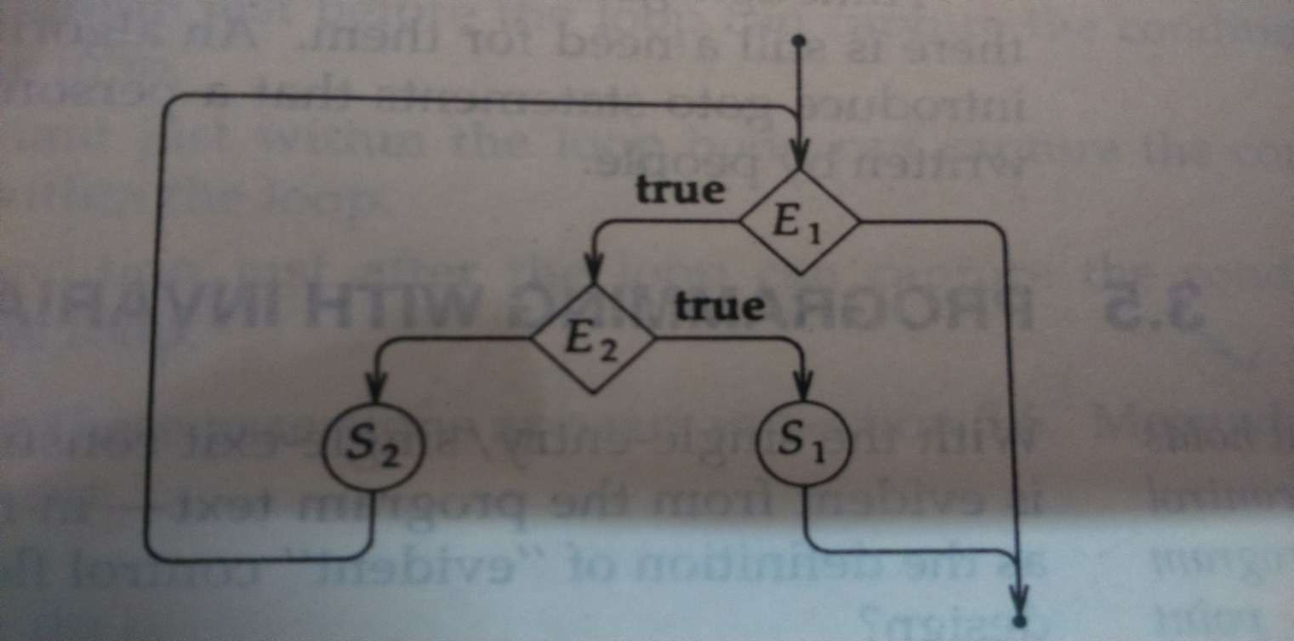
Flow diagram
While loop has a single entry / single exit but the control can reach the exit in 2 ways i.e. either from test E1 or after the statement S1 (due to break statement).
Pilani Campus

Slide 30
Programming with Invariants
In single entry / single exit, program flow is evident from the text.
With single entry / single exit, the behavior of a statement can be characterized purely by the conditions at the entry and exit to the statement. Such conditions are called as the pre-conditions and the post-conditions.
Invariants are the properties that hold every time the control reaches that point.
Invariant is an assertion that must hold for staying within the loop.
Preconditions/ postconditions are the conditions that must hold for entry and exit from the loop.
Pilani Campus

Slide 31
Example
while (x >= y) do
{ x >= y } // Invariant
x = x – y ;
Pilani Campus

Slide 32
Example: Linear search
start with the last inserted element
while elements remain to be examined do begin
if this element is x then
return its position
else
consider the element to its left
end
not found, so return 0
The program is well-structured but not single entry / single exit as the control can leave the conditional either by returning or by flowing through the else part to the program point after the conditional.
Pilani Campus

Slide 33
Linear search using invariants
i = 0
n
0
i
n
x | …
x | … | x | …
Case: x is not in the array (i=0)
Case: Most recent x is A[i],
(0< i<= n)
Combined case: x=A[i] and x is not in A[i+1..n]
Pilani Campus

Slide 34
Program
Initialization;
do the search;
{(x is not in the table) or (the most recent x is A[i] and 0<i<=n)} → Postcondition
if x is not in the table then
return 0;
else
return i;
Initialization;
do the search;
{ x =A[i] and x is not in A[i+1..n] and 0<=i<=n } → Postcondition
return i;
Pilani Campus

Slide 35
Program
A[0]= x;
i=n;
while (x!=A[i])
{x != A[i] }→ Invariant
i=i-1;
{ x =A[i] and x is not in A[i+1..n] and 0<=i<=n } → Postcondition
return i;
Pilani Campus

Slide 36
Example: Insertion sort
Problem: sort n numbers in A[0..n].
Input: n, numbers in A
Output: A in sorted order: ∀ i ∈ [0..n], A[i-1] <= A[i]
void insertsort (int A[], int n)
{
int i, j, key;
for i=1 to n
{
key=A[i];
j=i;
while (j>0) and (key<A[j-1])
{
A[j]=A[j-1];
j=j-1;
}
A[j]=key;
}
}
Pilani Campus

Slide 37
Programming using Invariants
void insertsort (int A[], int n)
{
int i, j, key;
{A[0] is sorted, n>0 } → precondition
for i=1 to n
{ { A[0] to A[i-1] is sorted } → Invariant
key=A[i];
j=i;
{(j>0 and key < A[j-1]) }→ precondition
while (j>0) and (key<A[j-1])
{
{(j>0&&j<=i && key<= A[k] for all k = j-1 to i)}→ Invariant
A[j]=A[j-1];
j=j-1;
}
{A[j+1] to A[i] is sorted} → postcondition
A[j]=key;
// A[0] to A[i] is sorted
}
{All elements A[0] to A[n] are sorted } → postcondition
}
Pilani Campus

Slide 38
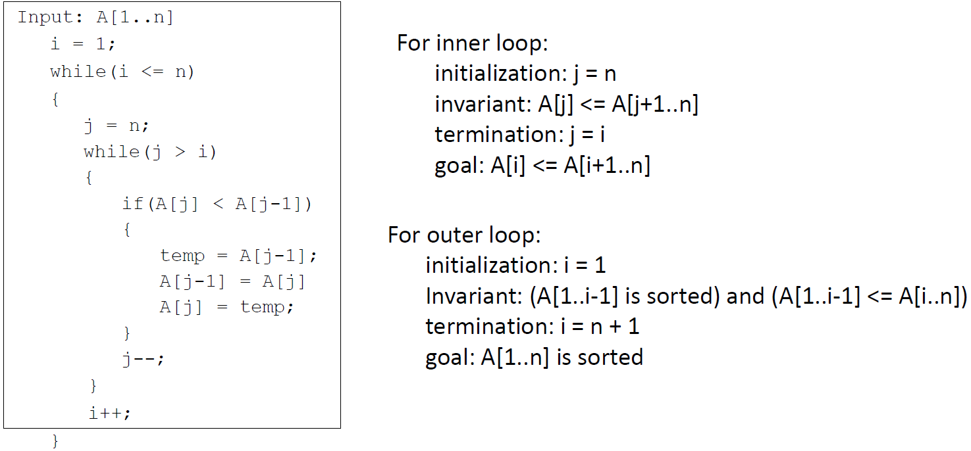
Example: Finding Loop invariant
Pilani Campus

Slide 39
Example: Binary Search
main()
{
int n, a[100], item, loc, beg, end, mid, i, flag=0;
scanf(%d”, &n);
for (i=0;i<=n-1;i++)
scanf(“%d”, &a[i]);
scanf(“%d”, &item);
loc=0; beg=0; end=n-1;
while ((beg<=end) && (A[beg]<item<A[end] ))
{
if (item==a[mid])
{
printf (“search successful”);
loc=mid;
printf(“ location of item is %d”, loc+1);
flag=flag+1;
break;
}
else if (item < a[mid])
end=mid-1;
else
beg =mid+1;
mid=(beg+end)/2;
}
if (flag==0)
printf (“search not successful”);
}
Pilani Campus

Slide 40
Invariants in binary search
Pre-condition:
(beg <=end) and (A[0] to A[n-1] is sorted).
Invariant:
(beg <=end) and (A[beg]<item<A[end])
Post-condition:
Item found at location (loc+1) and flag =1 else search is unsuccessful and flag=0.
Pilani Campus

